Slide 1
DEDICATED
TO
THE LOTUS FEET
OF
BHAGAVAN SRI SATHYA SAI BABA

Slide 2
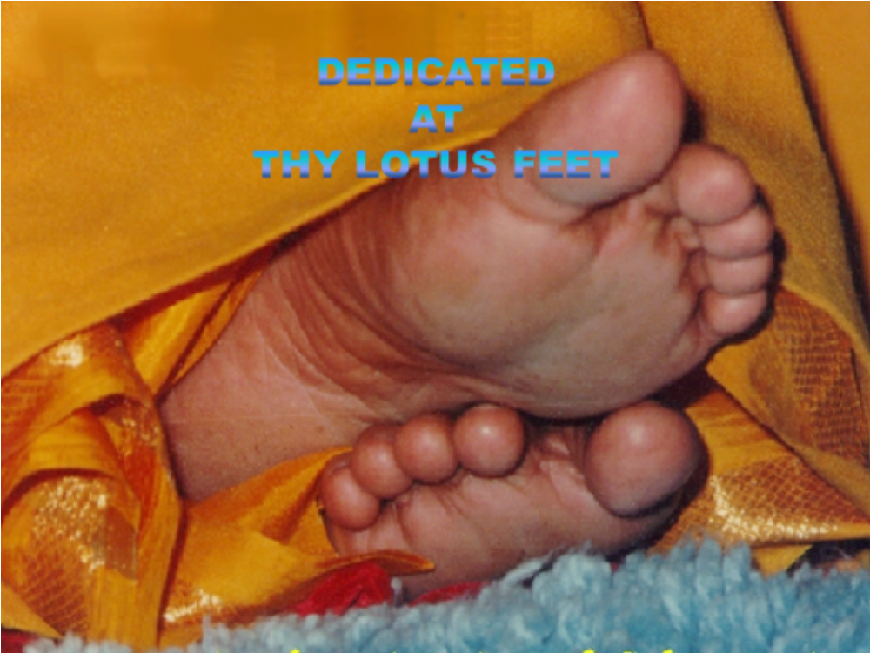

Slide 3
“LIVING WITH GOD IS TRUE EDUCATION”
EDUCARE
AT
SRI SATHYA SAI INSTITUTE OF HIGHER LEARNING

Slide 4
LPQs
WHAT IS TRUE EDUCATION?
WHAT IS EDUCARE
WHAT IS THE DIFFERENCE BETWEEN EDUCATION AND TRUE EDUCATION?
WHY IS LIVING WITH GOD - TRUE EDUCATION?
IS TRUE EDUCATION NOT POSSIBLE WITHOUT THIS?
HOW CAN STUDENTS OF SSSIHL CREATE SUCH CULTURE?

Slide 5
MESSAGE
OF
THE FOUNDER
AND
FOUNDER CHANCELLOR
OF
SRI SATHYA SAI INSTITUTE OF HIGHER LEARNING

Slide 6
THIS COLLEGE HAS NOT BEEN ESTABLISHED JUST TO PREPARE YOU FOR EARNING DEGREES. THE MAIN PURPOSE IS TO HELP YOU TO CULTIVATE SELF-KNOWLEDGE AND SELF-CONFIDENCE, SO THAT EACH ONE OF YOU CAN LEARN SELF-SACRIFICE AND EARN SELF-REALISATION. TEACHING THE UNIVERSITY CURRICULA, PREPARING YOU FOR THE EXAMINATIONS AND AWARDING UNIVERSITY DEGREES ARE ONLY THE MEANS EMPLOYED FOR THE END.

Slide 7
THE TIME IS APPROACHING WHEN ALL HUMANITY WILL LIVE IN HARMONY. THAT TIME WILL BE HERE SOONER THAN ONE EXPECTS. BEFORE IT ARISES, BE PREPARED FOR WHATEVER IS NEEDED TO REVEAL TO EVERY LIVING THING, THE TRUE PURPOSE OF EXISTENCE.

Slide 8
EDUCARE?
EDUCARE IS THE PROCESS OF BRINGING OUT THE PERFECTION
ALREADY THERE IN HUMAN BEINGS

Slide 9
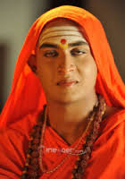
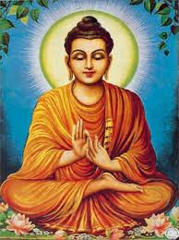

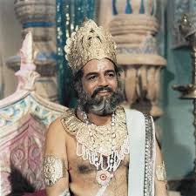
INTEGRAL EDUCATION
HEAD OF SHANKARA
+
HEART OF BUDDHA
+
HANDS OF JANAKA

Slide 10
PERFECTION - TRAITS
KNOWLEDGE | COMMUNICATION SKILLS
TECHNICAL COMPETENCE | CAPACITY TO WORK UNDER PRESSURE
TIME-MANAGEMENT | SELF-CONTROL
EMOTIONAL BALANCE | VISION
PEOPLE SKILLS | HONESTY/ SINCERITY/ COMMITMENT/ LOYALTY
DECISION-MAKING CAPABILITY | GROUP DYNAMICS & TEAM SKILLS

Slide 11
HYPOTHESIS
TRAITS OF PERFECTION ENHANCE MANAGERIAL EXCELLENCE
TRAITS OF PERFECTION CAN BE CULTIVATED THROUGH SYSTEMATIC CULTURE BUILDING LIFE-STYLE SYSTEMS AND PRACTICES

Slide 12
HOW CAN SUCH TRAITS BE CULTIVATED?
EDUCATIONAL TECHNOLOGY
  LECTURES
  EXPERIENTIAL LEARNING METHODS
VALUES ORIENTED LIFE-STYLE
  SIMPLE LIVING AND HIGH THINKING
  CONSCIOUSLY DESIGNED SCHEDULES
SPIRITUAL PRACTICES
  YOGA AND OTHER METHODS
  PRAYERS, CONGREGATIONAL SINGING, ETC.
  MEDITATION

Slide 13
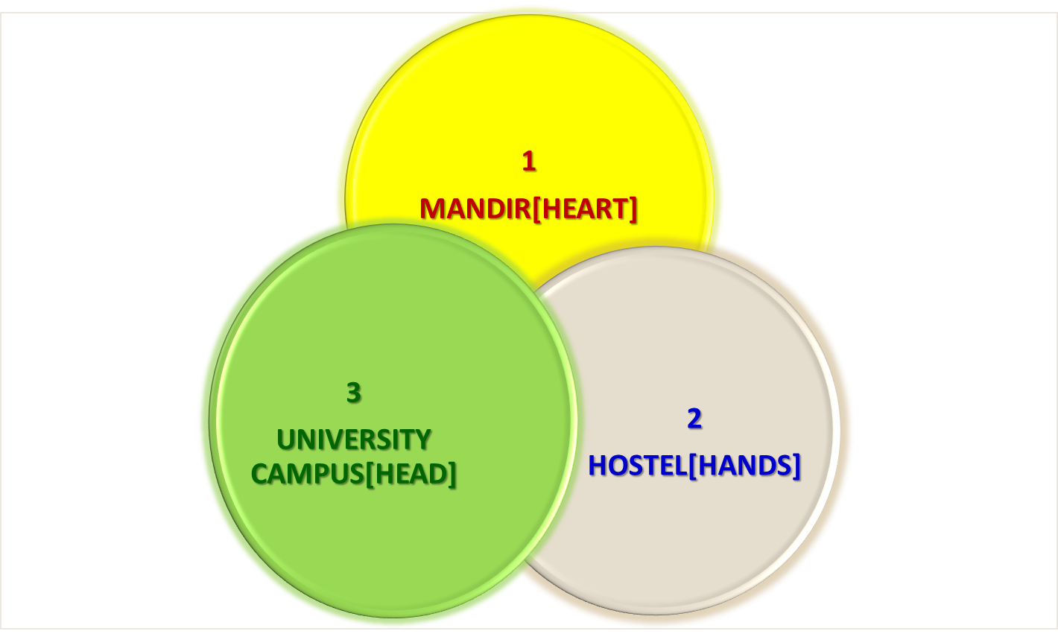
INTEGRAL EDUCATION

Slide 14
MANDIR/BHAGAVAN
UNIVERSITY
HOSTEL
TRAITS
KNOWLEDGE, SKILLS, TECHNICAL COMPETENCE, COMMUNICATION SKILLS, COMMITMENT, VISION, PEOPLE SKILLS, CAPACITY TO WORK UNDER PRESSURE, SELF-CONTROL, TIME-MANAGEMENT, EMOTIONAL BALANACE, HONESTY, LOYALTY, DECISION-MAKIKNG, TEAM-WORK

Slide 15

SCHEMATIC PRESENTATION OF VISION & MISSION
SYSTEM INPUTS TO STUDENTS
OUTCOMES
University Campus
Cost-free Values-Based
Education
Teaching of Regular
Courses
Examinations
Prayer Sessions
Awareness Courses
Moral Class Sessions
Gram Seva
Sports and Games
Cultural Activities
Instrumental Values
Cultural Sensitivity
Love for all Faiths
Unity and Harmony
Constant Integrated
Awareness
Awareness of National
Social Needs
Awareness of Needs of
Rural Populace
Simple Living & High
Thinking
Self-reliance
Modesty
Noble Character
Integrity
All-inclusiveness
Compassion
Terminal Values
Self Discovery
Self Knowledge
Spiritual Upliftment
Social Service with
Love & Detachment
Trusteeship
BHAGAVAN BABA
Residential Hostel
Dormitory Style of Living
Self-reliance Programmes
Satvic Food & Recreation
Holistic Ambience
SELF-LEADERSHIP
Functional Secular Traits
Knowledge and Skills
Talents
Healthy Body and Mind
Pursuit of Excellence in
Chosen Academic Discipline
Ashram Interface
Darshan of Bhagavan
Bhajans with Bhagavan
Interaction with Bhagavan
Talks by Elders
Cultural Programmes from
Different States & Countries
Presentation of Programmes
by Students of University

Slide 16
GOOD LUCK
AND
SAI RAM

